Slide 1
Exceptional Handling

Slide 2
An exception is an abnormal condition that arises in a code sequence at run time.
In other words, an exception is a run-time error.
In computer languages that do not support exception handling, errors must be checked and handled manually—typically through the use of error codes, and so on

Slide 3
Exception-Handling Fundamentals
A Java exception is an object that describes an exceptional (that is, error) condition that has occurred in a piece of code.
When an exceptional condition arises, an object representing that exception is created and thrown in the method that caused the error.
That method may choose to handle the exception itself, or pass it on. Either way, at some point, the exception is caught and processed.
Exceptions can be generated by the Java run-time system, or they can be manually generated by your code.
Exceptions thrown by Java relate to fundamental errors that violate the rules of the Java language or the constraints of the Java execution environment.
Manually generated exceptions are typically used to report some error condition to the caller of a method.
Java exception handling is managed via five keywords: try, catch, throw, throws, and finally.

Slide 4
Program statements that you want to monitor for exceptions are contained within a try block.
If an exception occurs within the try block, it is thrown.
Your code can catch this exception (using catch) and handle it in some rational manner.
System-generated exceptions are automatically thrown by the Java run-time system.
To manually throw an exception, use the keyword throw.
Any exception that is thrown out of a method must be specified as such by a throws clause.
Any code that absolutely must be executed before a method returns is put in a finally block.

Slide 5
This is the general form of an exception-handling block:
try {
// block of code to monitor for errors
}
catch (ExceptionType1 exOb) {
// exception handler for ExceptionType1
}
catch (ExceptionType2 exOb) {
// exception handler for ExceptionType2
}
// ...
finally {
// block of code to be executed before try block ends
}
Here, ExceptionType is the type of exception that has occurred

Slide 6
Exception Types
All exception types are subclasses of the built-in class Throwable.
Thus, Throwable is at the top of the exception class hierarchy.
Immediately below Throwable are two subclasses that partition exceptions into two distinct branches.
One branch is headed by Exception. This class is used for exceptional conditions that user programs should catch.
This is also the class that you will subclass to create your own custom exception types.
There is an important subclass of Exception, called RuntimeException.
Exceptions of this type are automatically defined for the programs that you write and include things such as division by zero and invalid array indexing.
The other branch is topped by Error, which defines exceptions that are not expected to be caught under normal circumstances by your program.
Exceptions of type Error are used by the Java run-time system to indicate errors having to do with the run-time environment, itself.
Stack overflow is an example of such an error.

Slide 7
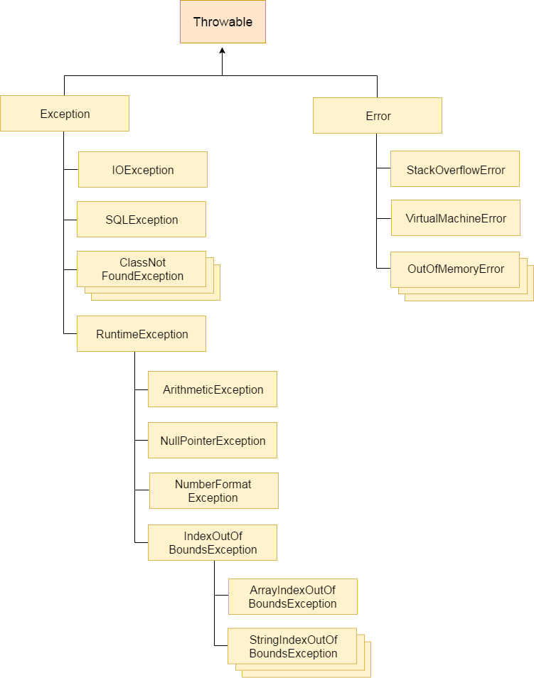

Slide 8
Uncaught Exceptions
What happens when you don’t handle them.
class Exc0 {
public static void main(String args[]) {
int d = 0;
int a = 42 / d;
}
}
When the Java run-time system detects the attempt to divide by zero, it constructs a new exception object and then throws this exception.
This causes the execution of Exc0 to stop, because once an exception has been thrown, it must be caught by an exception handler and dealt with immediately.

Slide 9
In this example, we haven’t supplied any exception handlers of our own, so the exception is caught by the default handler provided by the Java run-time system.
Any exception that is not caught by your program will ultimately be processed by the default handler.
The default handler displays a string describing the exception, prints a stack trace from the point at which the exception occurred, and terminates the program.
Here is the output generated when this example is executed.
java.lang.ArithmeticException: / by zero
at Exc0.main(Exc0.java:4)
Notice how the class name, Exc0; the method name, main; the filename, Exc0.java; and the line number, 4, are all included in the simple stack trace.
Also, notice that the type of the exception thrown is a subclass of Exception called ArithmeticException, which more specifically describes what type of error happened.

Slide 10
The stack trace will always show the sequence of method invocations that led up to the error.
For example, here is another version of the preceding program that introduces the same error but in a method separate from main( ):
class Exc1 {
static void subroutine() {
int d = 0;
int a = 10 / d;
}
public static void main(String args[]) {
Exc1.subroutine();
}
}
The resulting stack trace from the default exception handler shows how the entire call stack is displayed:
java.lang.ArithmeticException: / by zero
at Exc1.subroutine(Exc1.java:4)
at Exc1.main(Exc1.java:7)
As you can see, the bottom of the stack is main’s line 7, which is the call to subroutine( ), which caused the exception at line 4. The call stack is quite useful for debugging, because it pinpoints the precise sequence of steps that led to the error.

Slide 11
Using try and catch
Although the default exception handler provided by the Java run-time system is useful for debugging, you will usually want to handle an exception yourself.
Doing so provides two benefits.
First, it allows you to fix the error.
Second, it prevents the program from automatically terminating. Most users would be confused (to say the least) if your program stopped running and printed a stack trace whenever an error occurred! Fortunately, it is quite easy to prevent this.
To guard against and handle a run-time error, simply enclose the code that you want to monitor inside a try block.
Immediately following the try block, include a catch clause that specifies the exception type that you wish to catch.

Slide 12
class Exc2 {
public static void main(String args[]) {
int d, a;
try { // monitor a block of code.
d = 0;
a = 42 / d;
System.out.println("This will not be printed.");
} catch (ArithmeticException e) { // catch divide-by-zero error
System.out.println("Division by zero.");
}
System.out.println("After catch statement.");
}
}
This program generates the following output:
Division by zero.
After catch statement.

Slide 13
A try and its catch statement form a unit.
The scope of the catch clause is restricted to those statements specified by the immediately preceding try statement.
A catch statement cannot catch an exception thrown by another try statement (except in the case of nested try statements, described shortly).
The statements that are protected by try must be surrounded by curly braces. (That is, they must be within a block.)
You cannot use try on a single statement.
The goal of most well-constructed catch clauses should be to resolve the exceptional condition and then continue on as if the error had never happened.
For example, in the next program each iteration of the for loop obtains two random integers.
Those two integers are divided by each other, and the result is used to divide the value 12345.
The final result is put into a.
If either division operation causes a divide-by-zero error, it is caught, the value of a is set to zero, and the program continues

Slide 14
import java.util.Random;
class HandleError {
public static void main(String args[]) {
int a=0, b=0, c=0;
Random r = new Random();
for(int i=0; i<10; i++) {
try {
b = r.nextInt();
c = r.nextInt();
a = 12345 / (b/c);
} catch (ArithmeticException e) {
System.out.println("Division by zero.");
a = 0; // set a to zero and continue
}
System.out.println("a: " + a);
}
}
}

Slide 15
Displaying a Description of an Exception
Throwable overrides the toString( ) method (defined by Object) so that it returns a string containing a description of the exception.
You can display this description in a println( ) statement by simply passing the exception as an argument.
For example, the catch block in the preceding program can be rewritten like this:
catch (ArithmeticException e) {
System.out.println("Exception: " + e);
a = 0; // set a to zero and continue
}
When this version is substituted in the program, and the program is run, each divide-by-zero error displays the following message:
Exception: java.lang.ArithmeticException: / by zero

Slide 16
Multiple catch Clauses
In some cases, more than one exception could be raised by a single piece of code.
To handle this type of situation, you can specify two or more catch clauses, each catching a different type of exception.
When an exception is thrown, each catch statement is inspected in order, and the first one whose type matches that of the exception is executed.
After one catch statement executes, the others are bypassed, and execution continues after the try/catch block.

Slide 17
class MultiCatch {
public static void main(String args[]) {
try {
int a = args.length;
System.out.println("a = " + a);
int b = 42 / a;
int c[] = { 1 };
c[42] = 99;
} catch(ArithmeticException e) {
System.out.println("Divide by 0: " + e);
} catch(ArrayIndexOutOfBoundsException e) {
System.out.println("Array index oob: " + e);
}
System.out.println("After try/catch blocks.");
}
}

Slide 18
This program will cause a division-by-zero exception if it is started with no commandline parameters, since a will equal zero.
It will survive the division if you provide a command-line argument, setting a to something larger than zero.
But it will cause an ArrayIndexOutOfBoundsException, since the int array c has a length of 1, yet the program attempts to assign a value to c[42].
Here is the output generated by running it both ways:
C:\>java MultiCatch
a = 0
Divide by 0: java.lang.ArithmeticException: / by zero
After try/catch blocks.
C:\>java MultiCatch TestArg
a = 1
Array index oob: java.lang.ArrayIndexOutOfBoundsException
After try/catch blocks.

Slide 19
When you use multiple catch statements, it is important to remember that exception subclasses must come before any of their superclasses.
This is because a catch statement that uses a superclass will catch exceptions of that type plus any of its subclasses.
Thus, a subclass would never be reached if it came after its superclass.
Further, in Java, unreachable code is an error.

Slide 20
class SuperSubCatch {
public static void main(String args[]) {
try {
int a = 0;
int b = 42 / a;
} catch(Exception e) {
System.out.println("Generic Exception catch.");
}
/* This catch is never reached because
ArithmeticException is a subclass of Exception. */
catch(ArithmeticException e) { // ERROR - unreachable
System.out.println("This is never reached.");
} } }
If you try to compile this program, you will receive an error message stating that the second catch statement is unreachable because the exception has already been caught.
Since ArithmeticException is a subclass of Exception, the first catch statement will handle all Exception-based errors, including ArithmeticException. This means that the second catch statement will never execute.
To fix the problem, reverse the order of the catch statements

Slide 21
Nested try Statements
The try statement can be nested.
That is, a try statement can be inside the block of another try.
Each time a try statement is entered, the context of that exception is pushed on the stack.
If an inner try statement does not have a catch handler for a particular exception, the stack is unwound and the next try statement’s catch handlers are inspected for a match.
This continues until one of the catch statements succeeds, or until all of the nested try statements are exhausted. If no catch statement matches, then the Java run-time system will handle the exception.

Slide 22
class NestTry {
public static void main(String args[]) {
try {
int a = args.length;
/* If no command-line args are present,
the following statement will generate
a divide-by-zero exception. */
int b = 42 / a;
System.out.println("a = " + a);
try { // nested try block
if(a==1) a = a/(a-a); // division by zero
if(a==2) {
int c[] = { 1 };
c[42] = 99;} catch(ArrayIndexOutOfBoundsException e) {
System.out.println("Array index out-of-bounds: " + e); }
} catch(ArithmeticException e) {
System.out.println("Divide by 0: " + e);
} } }

Slide 23
C:\>java NestTry
Divide by 0: java.lang.ArithmeticException: / by zero
C:\>java NestTry One
a = 1
Divide by 0: java.lang.ArithmeticException: / by zero
C:\>java NestTry One Two
a = 2
Array index out-of-bounds:
java.lang.ArrayIndexOutOfBoundsException

Slide 24
Nesting of try statements can occur in less obvious ways when method calls are involved. For example, you can enclose a call to a method within a try block.
Inside that method is another try statement. In this case, the try within the method is still nested inside the outer try block, which calls the method.

Slide 25
class MethNestTry {
static void nesttry(int a) {
try { // nested try block
if(a==1) a = a/(a-a); // division by zero
if(a==2) {
int c[] = { 1 };
c[42] = 99; // generate an out-of-bounds exception
}
} catch(ArrayIndexOutOfBoundsException e) {
System.out.println("Array index out-of-bounds: " + e);
} }
public static void main(String args[]) {
try {
int a = args.length;
int b = 42 / a;
System.out.println("a = " + a);
nesttry(a);
} catch(ArithmeticException e) {
System.out.println("Divide by 0: " + e); } } }

Slide 26
throw
It is possible for your program to throw an exception explicitly, using the throw statement.
The general form of throw is shown here:
throw ThrowableInstance;
Here, ThrowableInstance must be an object of type Throwable or a subclass of Throwable.
Simple types, such as int or char, as well as non-Throwable classes, such as String and Object, cannot be used as exceptions.
There are two ways you can obtain a Throwable object: using a parameter into a catch clause, or creating one with the new operator.
The flow of execution stops immediately after the throw statement; any subsequent statements are not executed.
The nearest enclosing try block is inspected to see if it has a catch statement that matches the type of the exception.
If it does find a match, control is transferred to that statement. If not, then the next enclosing try statement is inspected, and so on.
If no matching catch is found, then the default exception handler halts the program and prints the stack trace.

Slide 27
class ThrowDemo {
static void demoproc() {
try {
throw new NullPointerException("demo");
} catch(NullPointerException e) {
System.out.println("Caught inside demoproc.");
throw e; // rethrow the exception
}
}
public static void main(String args[]) {
try {
demoproc();
} catch(NullPointerException e) {
System.out.println("Recaught: " + e);
}
}
}
Output:
Caught inside demoproc.
Recaught: java.lang.NullPointerException: demo

Slide 28
throws
If a method is capable of causing an exception that it does not handle, it must specify this behavior so that callers of the method can guard themselves against that exception.
You do this by including a throws clause in the method’s declaration.
A throws clause lists the types of exceptions that a method might throw.
This is necessary for all exceptions, except those of type Error or RuntimeException, or any of their subclasses.
All other exceptions that a method can throw must be declared in the throws clause.
If they are not, a compile-time error will result.
This is the general form of a method declaration that includes a throws clause:
type method-name(parameter-list) throws exception-list
{
// body of method
}
Here, exception-list is a comma-separated list of the exceptions that a method can throw.

Slide 29
// This program contains an error and will not compile.
class ThrowsDemo {
static void throwOne() {
System.out.println("Inside throwOne.");
throw new IllegalAccessException("demo");
}
public static void main(String args[]) {
throwOne();
}
}
To make this example compile, you need to make two changes.
First, you need to declare that throwOne( ) throws IllegalAccessException.
Second, main( ) must define a try/catch statement that catches this exception.

Slide 30
finally
finally creates a block of code that will be executed after a try/catch block has completed and before the code following the try/catch block.
The finally block will execute whether or not an exception is thrown.
If an exception is thrown, the finally block will execute even if no catch statement matches the exception.
Any time a method is about to return to the caller from inside a try/catch block, via an uncaught exception or an explicit return statement, the finally clause is also executed just before the method returns.
This can be useful for closing file handles and freeing up any other resources that might have been allocated at the beginning of a method with the intent of disposing of them before returning.
The finally clause is optional.
However, each try statement requires at least one catch or a finally clause.

Slide 31
class FinallyDemo {
// Through an exception out of the method.
static void procA() {
try {
System.out.println("inside procA");
throw new RuntimeException("demo");
} finally {
System.out.println("procA's finally");
}
}
// Return from within a try block.
static void procB() {
try {
System.out.println("inside procB");
return;
} finally {
System.out.println("procB's finally");
}
}

Slide 32
// Execute a try block normally.
static void procC() {
try {
System.out.println("inside procC");
} finally {
System.out.println("procC's finally");
}
}
public static void main(String args[]) {
try {
procA();
} catch (Exception e) {
System.out.println("Exception caught");
}
procB();
procC();
}
}

Slide 33
Java’s Built-in Exceptions
Inside the standard package java.lang, Java defines several exception classes.
java.lang is implicitly imported into all Java programs, most exceptions derived from RuntimeException are automatically available.
Furthermore, they need not be included in any method’s throws list.
In the language of Java, these are called unchecked exceptions because the compiler does not check to see if a method handles or throws these exceptions.

Slide 34
Unchecked Exceptions:
ArithmeticException: Arithmetic error, such as divide-by-zero.
ArrayIndexOutOfBoundsException: Array index is out-of-bounds.
ArrayStoreException: Assignment to an array element of an incompatible type.
ClassCastException: Invalid cast.
IllegalArgumentException: Illegal argument used to invoke a method.
IllegalMonitorStateException: Illegal monitor operation, such as waiting on an unlocked thread.

Slide 35
IllegalStateException: Environment or application is in incorrect state.
IllegalThreadStateException: Requested operation not compatible with current thread state.
IndexOutOfBoundsException: Some type of index is out-of-bounds.
Ex:ArrayList
NegativeArraySizeException: Array created with a negative size.
NullPointerException: Invalid use of a null reference.
Ex:String ptr=null;
If(ptr.equals(“gfg”))
NumberFormatException: Invalid conversion of a string to a numeric format.
Int a=br.readLine();
SecurityException: Attempt to violate security.
Pckage java.util;
Class Test{……}
StringIndexOutOfBounds: Attempt to index outside the bounds of a string.
Str=“abc”
Ex:str.charAt(50);
UnsupportedOperationException: An unsupported operation was encountered.
Ex:asList is fixed in collection, we can’t add or remove elements from asList

Slide 36
Checked Exceptions:
ClassNotFoundException: Class not found.
CloneNotSupportedException: Attempt to clone an object that does not implement the Cloneable interface.
IllegalAccessException: Access to a class is denied.
InstantiationException: Attempt to create an object of an abstract class or interface.
InterruptedException: One thread has been interrupted by another thread.
NoSuchFieldException: A requested field does not exist.
NoSuchMethodException: A requested method does not exist.

Slide 37
Creating Your Own Exception Subclasses
class MyException extends Exception {
private int detail;
MyException(int a) {
detail = a; }
public String toString() {
return "MyException[" + detail + "]"; } }
class ExceptionDemo {
static void compute(int a) throws MyException {
System.out.println("Called compute(" + a + ")");
if(a > 10)
throw new MyException(a);
System.out.println("Normal exit"); }
public static void main(String args[]) {
try {
compute(1);
compute(20);
} catch (MyException e) {
System.out.println("Caught " + e);
} } }

Slide 38
Chained Exceptions
The chained exception feature allows you to associate another exception with an exception.
This second exception describes the cause of the first exception.
For example, imagine a situation in which a method throws an ArithmeticException because of an attempt to divide by zero.
However, the actual cause of the problem was that an I/O error occurred, which caused the divisor to be set improperly.
Although the method must certainly throw an ArithmeticException, since that is the error that occurred, you might also want to let the calling code know that the underlying cause was an I/O error.
Chained exceptions let you handle this, and any other situation in which layers of exceptions exist.
The constructors are shown here.
Throwable(Throwable causeExc)
Throwable(String msg, Throwable causeExc)

Slide 39
In the first form, causeExc is the exception that causes the current exception.
That is, causeExc is the underlying reason that an exception occurred.
The second form allows you to specify a description at the same time that you specify a cause exception.
These two constructors have also been added to the Error, Exception, and RuntimeException classes.
The chained exception methods added to Throwable are getCause( ) and initCause( ).
Throwable getCause( )
Throwable initCause(Throwable causeExc)

Slide 40
The getCause( ) method returns the exception that underlies the current exception.
If there is no underlying exception, null is returned.
The initCause( ) method associates causeExc with the invoking exception and returns a reference to the exception.
Thus, you can associate a cause with an exception after the exception has been created.
However, the cause exception can be set only once.
Thus, you can call initCause( ) only once for each exception object.
Furthermore, if the cause exception was set by a constructor, then you can’t set it again using initCause( ).
In general, initCause( ) is used to set a cause for legacy exception classes which don’t support the two additional constructors described earlier.
At the time of this writing, most of Java’s built-in exceptions, such as ArithmeticException, do not define the additional constructors.
Thus, you will use initCause( ) if you need to add an exception chain to these exceptions.
When creating your own exception classes you will want to add the two chained-exception constructors if you will be using your exceptions in situations in which layered exceptions are possible.

Slide 41
class ChainExcDemo {
static void demoproc() {
NullPointerException e =
new NullPointerException("top layer");
e.initCause(new ArithmeticException("cause"));
throw e;
}
public static void main(String args[]) {
try {
demoproc();
} catch(NullPointerException e) {
System.out.println("Caught: " + e);
System.out.println("Original cause: " +
e.getCause());
}
}
}
The output from the program is shown here.
Caught: java.lang.NullPointerException: top layer
Original cause: java.lang.ArithmeticException: cause

